Slide 1
String handling in Java

Slide 2
Box b1 = new Box(1000);
Box b4 = new Box(10.56f);
Sop(b1.toString());
Sop(b2.toString());
Sop(b1.height);
Sop(b2.height);
stack
heap
Box
---------
Height 10.56f
Box
---------
Height 1000
b2
b1

Slide 3
The String class represents array of characters.
All string literals in Java programs, such as "abc", are implemented as instances of this String class.
Strings are constant; their values cannot be changed after they are created.
For example:
String str = "abc"; is equivalent to:
char data[] = {'a', 'b', 'c'};
String str = new String(data);

Slide 4
Int x=100;
Int y=x;
Int z=100;
Int i=x;
String s1="Hello";
String s2="Hello";
String s3="Hello";
String s4="Hello";
If(s2==“Hello”)
{
}
S.O.P(“Hello”);
stack
heap
s4
s3
s2
s1
i=100
Z=100
Y=100
X=100
“Hello”

Slide 5
Int x=100;
Int y=x;
Int z=100;
Int i=x;
String s1="Hello";
String s2="Hello";
String s3="Hello";
String s4="Hello";
If(s2==“Hello”)
{
}
S.O.P(“Hello”);
Emp e1 =
new Emp(10);
Emp e2 =
new Emp(10);
stack
heap
e2
e1
s4
s3
s2
s1
i=100
Z=100
New Emp()
Y=100
New Emp()
X=100
“Hello”

Slide 6
P s v main(….)
{
sop();
test();
sop();
}
Public static void test() {
Int x = 100;
Int y = 5;
boolean b=(100==100)
boolean b1=(x==y)
}

Slide 7
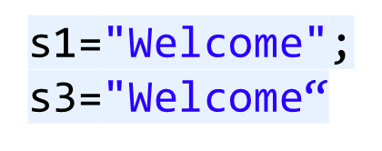
Int x=100;
Int y=x;
Int z=100;
Int i=x;
String s1="Hello";
String s2="Hello";
String s3="Hello";
String s4="Hello";
If(s2==“Hello”)
{
}
S.O.P(“Hello”);
Emp e1 = new Emp();
Emp e2 = new Emp();
stack
heap
e2
e1
s4
s3
s2
s1
“Welcome”
i=100
Z=100
New Emp()
Y=100
New Emp()
X=100
“Hello”

Slide 8
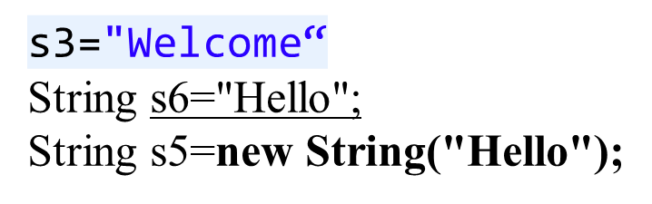
stack
heap
s6
s5
s4
s3
s2
s1
i=100
“Hello”
Z=100
Y=100
“Welcome”
X=100
“Hello”

Slide 9
for(int i=0;i<10;i++)
{
String s1="Hello";
}
System.out.println(s1);
----------------------
String s2="Hello";
for(int i=0;i<10;i++)
{
s2 ="Hello";
// s2 = new String(“Hello”);
}
System.out.println(s2);
---------------------------------
s2
s1
“Hello”

Slide 10
This approach is used because fixed, immutable strings can
be implemented more efficiently than changeable ones.
However if modifiable is desired, there is a companion class
or String StringBuffer whose objects contain Strings that
can be modified after they are created.

Slide 11
The String Constructors
1. String firstString =new String();
A String by variable name s1 does not contain any value.
2. char data[]={‘a’, ‘b’, ‘c’};
String secondString =new String (data);
3. char data[]={‘a’, ‘b’, ‘c’, ‘d’, ‘e’, ‘f’};
String thirdString =new String(data,2,3); //(s=cde)

Slide 12
4. Char c[]={‘j’,’a’,’v’,’a’};
String s1 =new String (c);
String s2=new String (s1);
5. byte ascii[]={65,66,67,68,69};
String s3=new String(ascii)
S.o.p(s3);//ABCDE

Slide 13
Special String Operators
1. String Concatenation
String age=“nine”;
String s1=“He is ”+age+“ years old”;
(s=He is 9 years old)
2. String concatenation with other Datatypes
int age=9;
String s2=“He is ”+age+“ years old”;
Age gets automatically converted to String representation

Slide 14
Character Extraction
1. Str.charAt();
2. getChars(); //This can extract more than one character.
String str=“Demo Package made in Java”;
int start=5;
int end=10;
char ch[]=new char[end-start];
str.getChars(start,end,ch,0);
3. getBytes();
getBytes() is an alternative for getchars. It will store the
characters in an array of bytes.

Slide 15
String Comparison
1. Str.equals(str2);
2. Str.equalsIgnoreCase(str2);
3. startsWith() and endsWith()
“Football”.endsWith(“ball”);
“Football”.startsWith(“Foo”);
“Football”.startsWith(“ball”,4);
This will return a boolean.

Slide 16
SB
Helloworld dsfdsf fdfd 323232 344 fdgfdfg 3434 dfdfd dfgfdg 43443 fdgfd
String firstString =“Helloworld";
String stringInUppercase=firstString.toUpperCase();
HELLOWORLD
Helloworld
Helloworld

Slide 17
4. compareTo()
---Often it is not enough to simply know whether two strings
are identical. For sorting applications, you need to know which
is less than, equal to or greater than the next.
Ex: A bubble sort for string using compareTo
class Sortstring{
Static String arr[]={“now”,”is”,”the”,”time”,”for”,”all”,”good”,
“men”,”to”,”come”,”to”,”the”,”aid”,”of”,”their”,”country”};
public static void main(String args[]){
for(int j=0;j<arr.length;j++){
for(int I=j+1;I<arr.length;I++){
if(arr[I].compareTo(arr[j])<0){
String t=arr[j];
arr[j]=arr[I];
arr[I]=t; } }
System.out.println(arr[j]); } } }

Slide 18
Search Strings
- indexOf(String str)
String str=“Hello World”;
System.out.println(str.indexOf(‘W’)
System.out.println(str.lastIndexOf(‘o’);
Modifying a String
String substring(int startIndex)
String substring(int startindex, int endindex)

Slide 19
String.split()
String s1=“Mon,Tue,wed,thur,fri,sat,sun”;
String[] weeks=s1.split(“,”);
Int count=weeks.length;
System.out.println(“Word Count ”+count);
For (int i=0;i<count;i++)
{
System.out.println(weeks[i]);
}
--------------------------------------------------
String s1=“a=120;b=25;c=a+b;print c”;

Slide 20
How much memory does a string use in Java 8
A String contains the following:
  a char array— thus a separate object— containing the actual characters;
  an integer offset into the array at which the string starts;
  the length of the string;
  another int for the cached calculation of the hash code.

Slide 21
24 bytes
This means even if the string contains no characters, it will require
4 bytes for the char array reference,
plus 3*4=12 bytes for the three int fields,
plus 8 bytes of object header.
This gives 24 bytes (which is a multiple of 8 so no "padding" bytes are needed so far)

